Slide 1

ME 165
Mechanical Engineering Fundamentals
Lecture 1
Introduction
Md. Aminul Islam
Lecturer
Department of Mechanical Engineering, BUET

Slide 2
Course Outline
3.00 Credit Hours
Internal combustion engines: Introduction to internal combustion engines and their cycles; gas turbines.
Refrigeration and air conditioning: psychrometry, applications; refrigerants, different refrigeration methods.
Statics of Particles and Rigid Bodies, Forces in Trusses and Frames, Relative Motion, Kinematics of Particles.
Introduction to robotics.
Sources of energy-Conventional and Renewable.

Slide 3
Course Outcomes
Upon the successful completion of the course, you should be able to-
Understand the basics of using mechanical engineering knowledge in practical fields.
Recognize various mechanical systems and processes like refrigeration and internal combustion engines.
Develop the ability to create electromechanical systems that solves problems
Apply the concepts mechanics to solve real world problems
Describe various energy sources and their utilization.

Slide 4
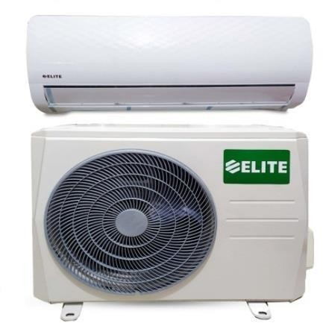
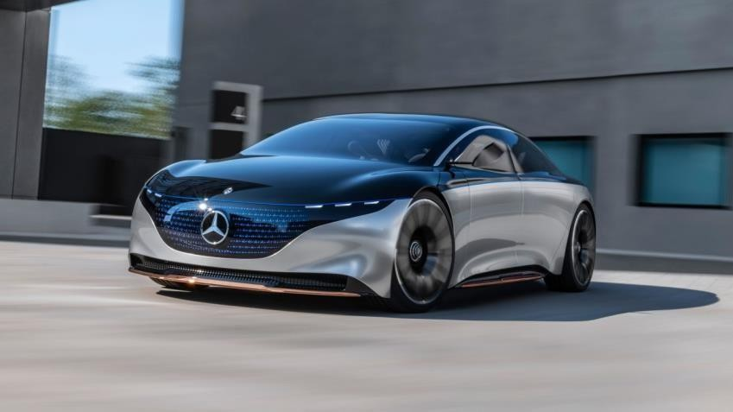
Course Outline
Internal combustion engines: Introduction to internal combustion engines and their cycles; gas turbines.
Source: https://aircare.com.bd/product/elite-1-0-ton-air-conditioner-non-inverter/
Refrigeration and air conditioning: applications;
refrigerants, different refrigeration methods.
Source: https://www.mercedes- benz.com/en/vehicles/passenger-cars/concept-cars/vision-eqs/

Slide 5
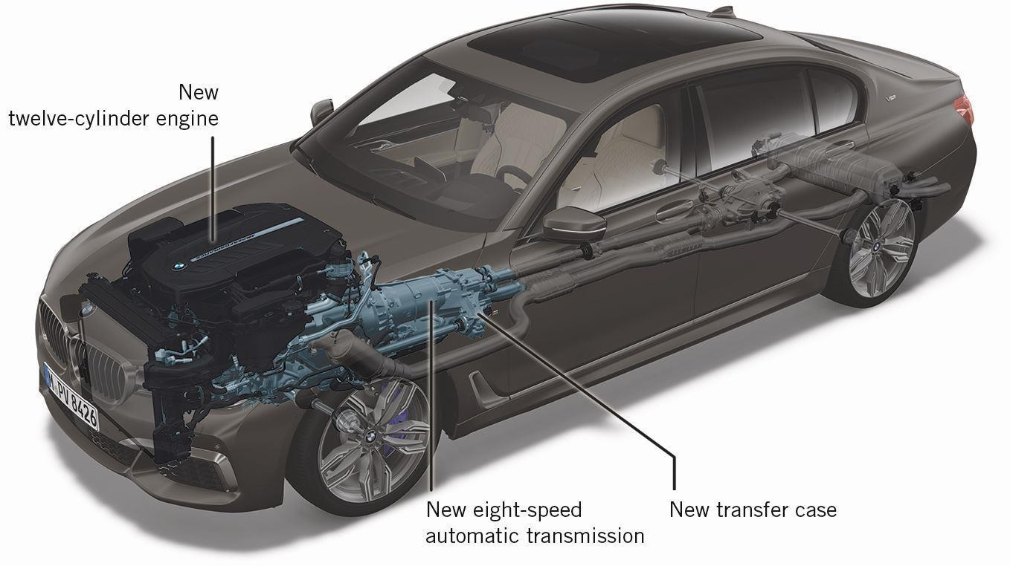
Internal Combustion Engine: Terminology and Classification

Slide 6
Engine
Engine: a device that transforms one form of energy into another
form of Energy.
Work
Source
Sink
Engine
Heat engine: Transform the heat energy into mechanical energy

Slide 7
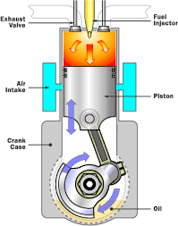
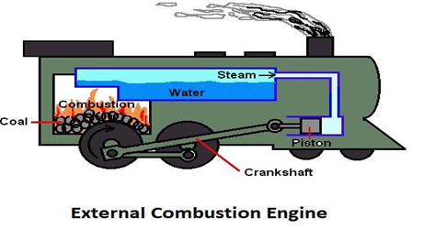
Classification
Heat Engine
External Combustion Engine (E.C.)
Internal Combustion Engine (E.C.)
Combustion of fuel takes place outside the cylinder
Combustion of fuel takes place inside the cylinder

Slide 8
Heat Engine
Heat Engine: A heat engine is a device which transforms the chemical energy of a fuel into thermal energy and uses this energy to produce mechanical work. It is classified into two types-
(a) External combustion engine (E. C. Engine)
(b) Internal combustion engine (I. C. Engine)
External combustion engine: In this engine, the products of combustion of air and fuel transfer heat to a second fluid which is the working fluid of the cycle.
Application: In the steam engine or a steam turbine plant, the heat of combustion is employed to generate steam which is used in a piston engine (reciprocating type engine) or a turbine (rotary type engine) for useful work.
Internal combustion engine: In this engine, the combustion of air and fuels take place inside the cylinder and are used as the direct motive force.
Application:
Mainly used as “prime mover”, e.g., for be the propulsion of avehicle
i.e., car, bus, truck, locomotive, marine vessel, or airplane.
Other applications includes stationary saws, lawnmowers, bull- dozers, cranes, electric generators etc.
10

Slide 9
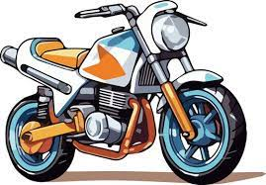
Internal Combustion Engine (IC Engine)

Slide 10
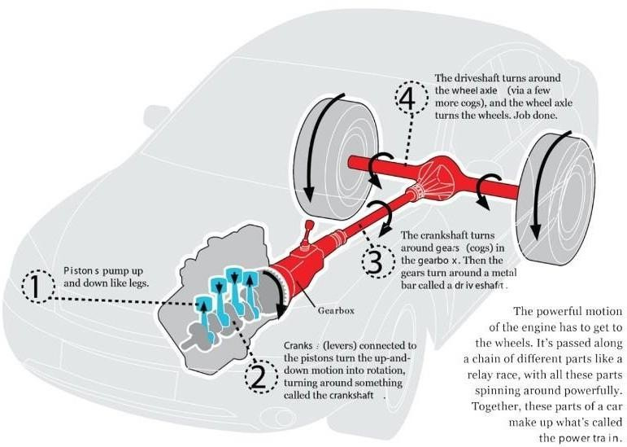
Internal Combustion Engine (IC Engine)

Slide 11
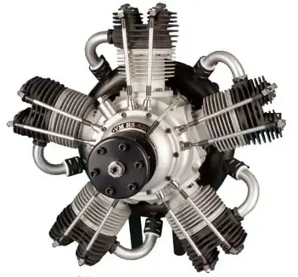
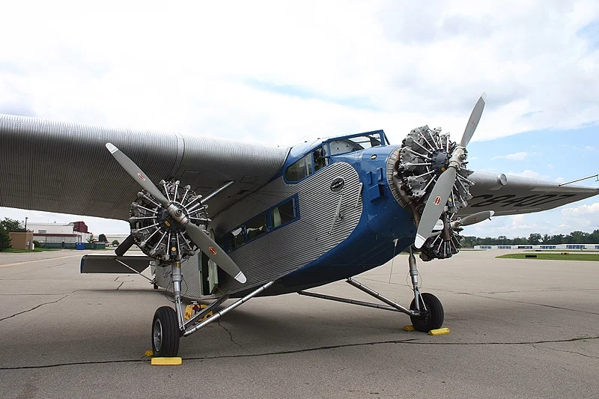
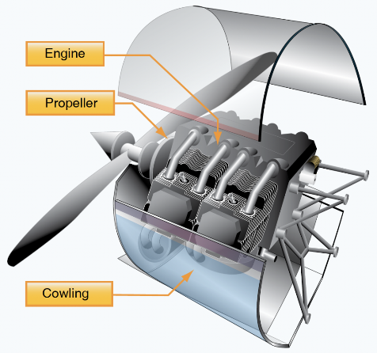
Internal Combustion Engine (IC Engine)

Slide 12

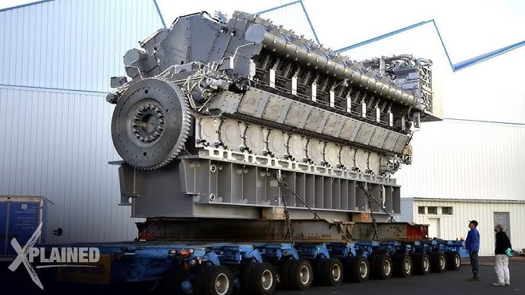
Internal Combustion Engine (IC Engine)

Slide 13
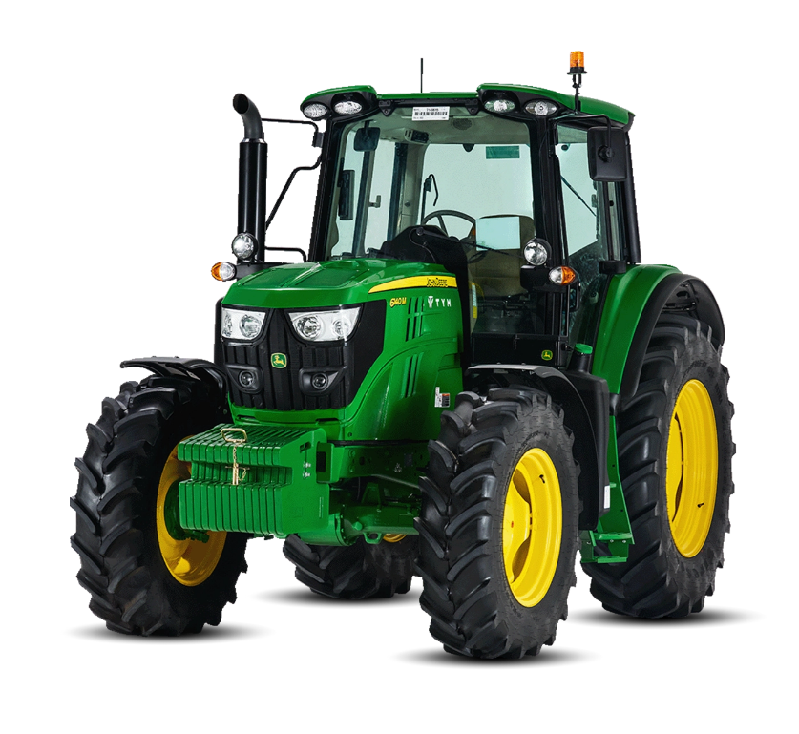
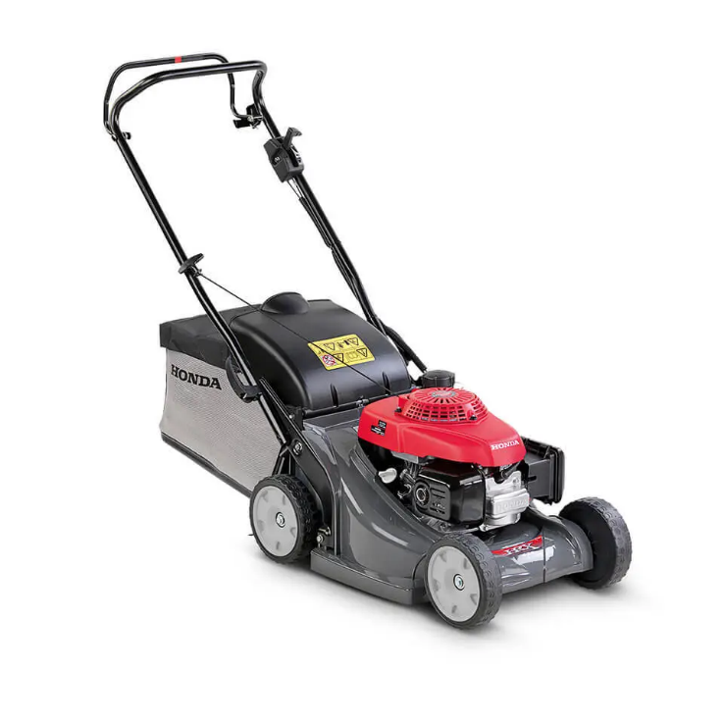
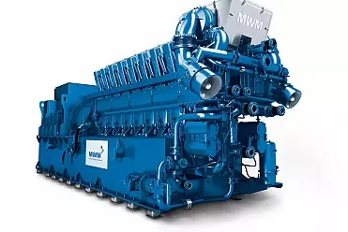
Internal Combustion Engine (IC Engine)
Generator
Tractor
Lawn Mower

Slide 14
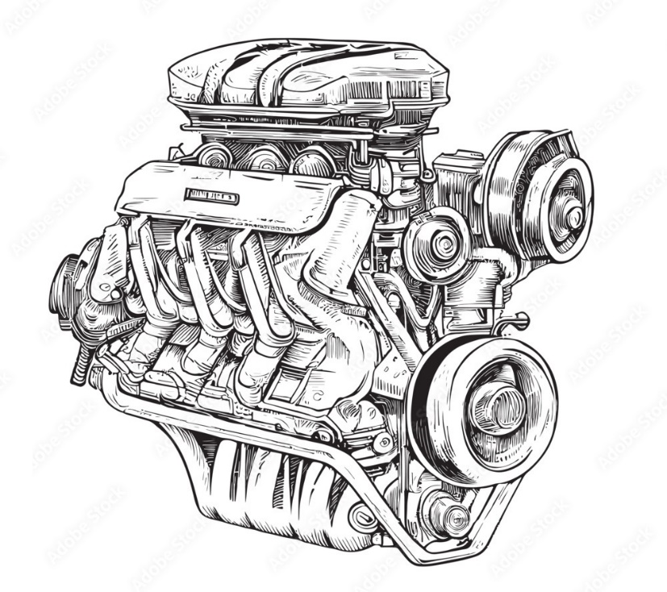
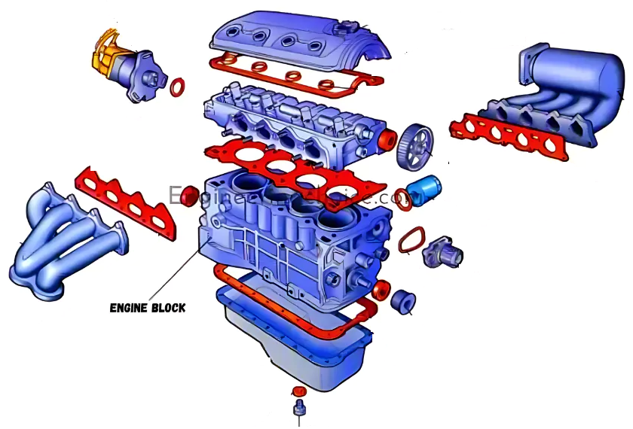
Internal Combustion Engines - Construction
Head block
Bottom Chamber

Slide 15
“Your potential is limitless unlock it today”

Slide 16
Acknowledgement
Slide Courtesy:
Dr. Aman Uddin, Assistant Professor, Department of Mechanical Engineering, BUET
Saif Al-Afsan Shamim, Assistant Professor, Department of Mechanical Engineering, BUET

